Slide 1
Advance Structure Analysis
“Stiffness Matrix Method”
By:
Asst. prof. Dr. Wissam D. Salman

Slide 2
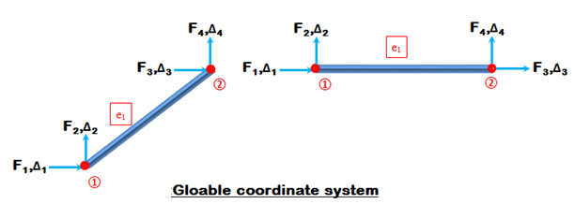
Bar Element or Truss Element **
In global coordinate system
$${[F]}^{e}= {[k]}^{e} . {[∆]}^{e}$$

Slide 3
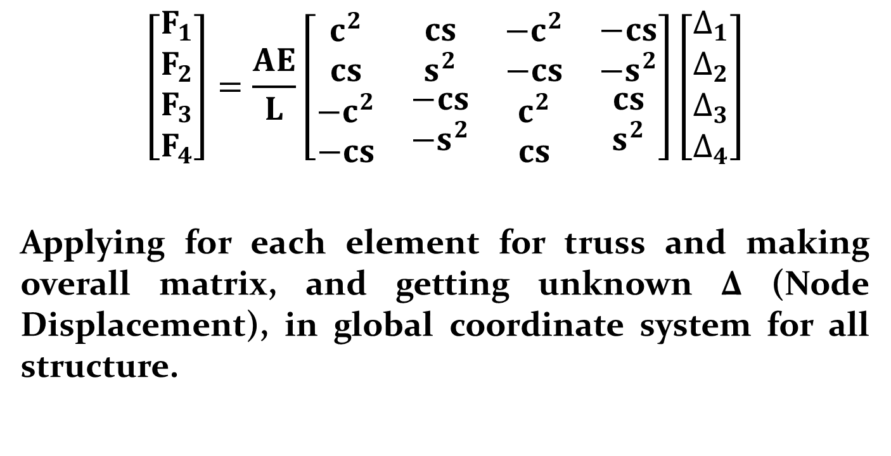
$$\left[\begin{matrix}\begin{matrix}F_{1} \\ F_{2}\end{matrix} \\ F_{3} \\ \begin{matrix}F_{4}\end{matrix}\end{matrix}\right]=\frac{AE}{L}\left[\begin{matrix}\begin{matrix}c^{2} \\ cs \\ \begin{matrix}−c^{2} \\ −cs\end{matrix}\end{matrix} & \begin{matrix}cs \\ s^{2} \\ \begin{matrix}−cs \\ −s^{2}\end{matrix}\end{matrix} & \begin{matrix}\begin{matrix}−c^{2} \\ −cs \\ \begin{matrix}c^{2} \\ cs\end{matrix}\end{matrix} & \begin{matrix}\begin{matrix}−cs \\ −s^{2} \\ \begin{matrix}cs \\ s^{2}\end{matrix}\end{matrix}\end{matrix}\end{matrix}\end{matrix}\right]\left[\begin{matrix}\begin{matrix}∆_{1} \\ ∆_{2}\end{matrix} \\ ∆_{3} \\ \begin{matrix}∆_{4}\end{matrix}\end{matrix}\right]$$
Applying for each element for truss and making overall matrix, and getting unknown ∆ (Node Displacement), in global coordinate system for all structure.

Slide 4
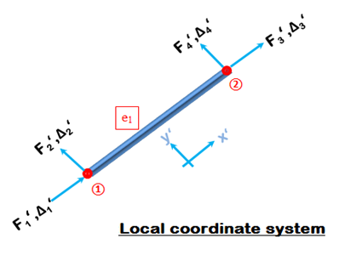
From above steps we find the displacements at nodes , then find support reactions for overall structures.
After that we need to compute the internal forces in each element of truss, so, we worked in local coordinate system.

Slide 5
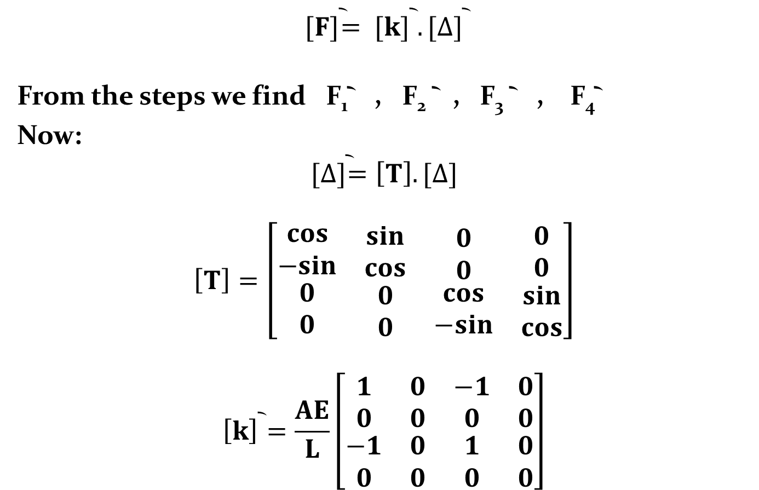
$${[F]}^{︡}= {[k]}^{︡} . {[∆]}^{︡}$$
From the steps we find F₁︡ , F₂ ︡ , F₃ ︡ , F₄︡
Now:
$${[∆]}^{︡}=\left[T\right].[∆]$$
$$\left[T\right]=\left[\begin{matrix}\begin{matrix}cos \\ −sin \\ \begin{matrix}0 \\ 0\end{matrix}\end{matrix} & \begin{matrix}sin \\ cos \\ \begin{matrix}0 \\ 0\end{matrix}\end{matrix} & \begin{matrix}\begin{matrix}0 \\ 0 \\ \begin{matrix}cos \\ −sin\end{matrix}\end{matrix} & \begin{matrix}\begin{matrix}0 \\ 0 \\ \begin{matrix}sin \\ cos\end{matrix}\end{matrix}\end{matrix}\end{matrix}\end{matrix}\right]$$
$${\left[k\right]}^{︡}=\frac{AE}{L}\left[\begin{matrix}\begin{matrix}1 \\ 0 \\ \begin{matrix}−1 \\ 0\end{matrix}\end{matrix} & \begin{matrix}0 \\ 0 \\ \begin{matrix}0 \\ 0\end{matrix}\end{matrix} & \begin{matrix}\begin{matrix}−1 \\ 0 \\ \begin{matrix}1 \\ 0\end{matrix}\end{matrix} & \begin{matrix}\begin{matrix}0 \\ 0 \\ \begin{matrix}0 \\ 0\end{matrix}\end{matrix}\end{matrix}\end{matrix}\end{matrix}\right]$$

Slide 6
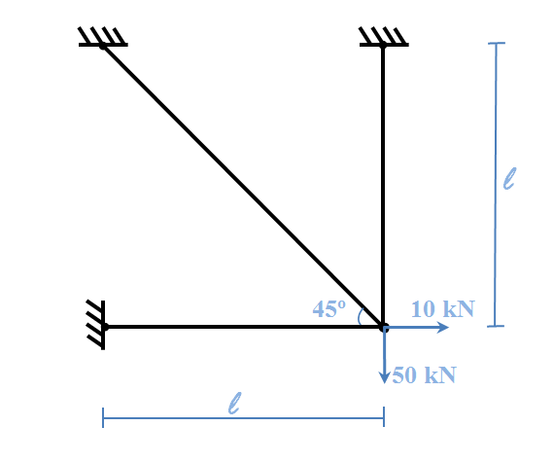
Example: Analyze the structure shown in figure below using stiffness matrix method.
Or: For the structure shown in figure below, find the node displacements, support reactions and members forces, using stiffness matrix method.

Slide 7
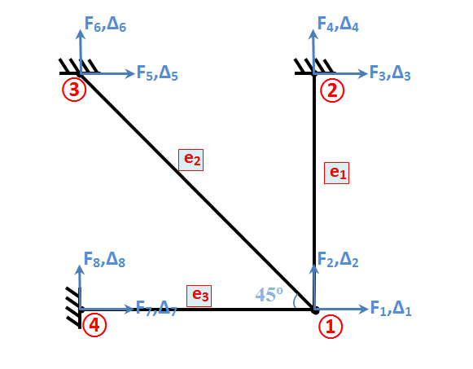
Solution:
Global coordinate system

Slide 8
From B.C. ∆₃ , ∆₄ , ∆₅ , ∆₆ , ∆₇ , ∆₈ equal to zero
:. Unknown ∆₁ & ∆₂
Element | Nodes | Ѳ | C | S | CS | C² | S² | AE/L
1 | 1-2 | 90 | 0 | 1 | 0 | 0 | 1 | AE/L
2 | 1-3 | 135 | -0.707 | 0.707 | -0.5 | 0.5 | 0.5 | 0.707AE/L
3 | 1-4 | 180 | -1 | 0 | 0 | 1 | 0 | AE/L

Slide 9
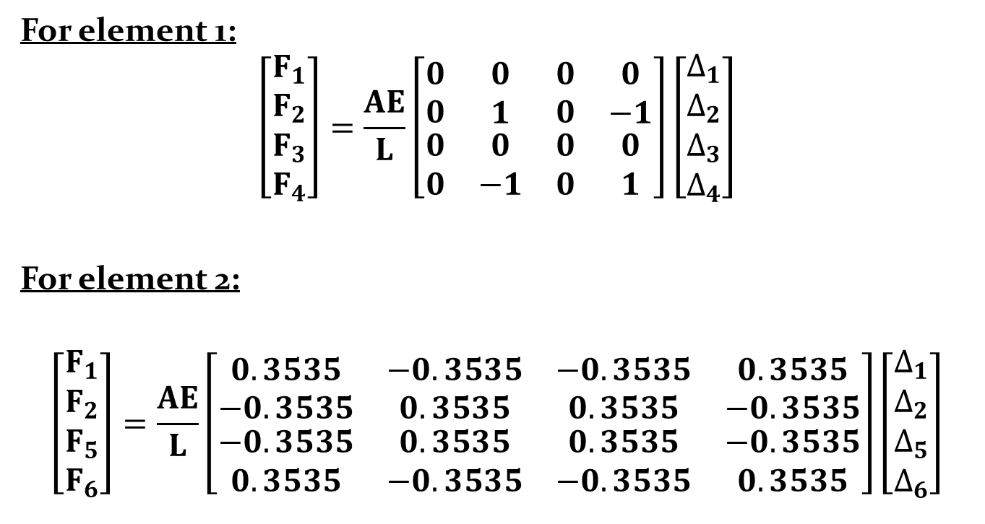
For element 1:
$$\left[\begin{matrix}\begin{matrix}F_{1} \\ F_{2}\end{matrix} \\ F_{3} \\ \begin{matrix}F_{4}\end{matrix}\end{matrix}\right]=\frac{AE}{L}\left[\begin{matrix}\begin{matrix}0 \\ 0 \\ \begin{matrix}0 \\ 0\end{matrix}\end{matrix} & \begin{matrix}0 \\ 1 \\ \begin{matrix}0 \\ −1\end{matrix}\end{matrix} & \begin{matrix}\begin{matrix}0 \\ 0 \\ \begin{matrix}0 \\ 0\end{matrix}\end{matrix} & \begin{matrix}\begin{matrix}0 \\ −1 \\ \begin{matrix}0 \\ 1\end{matrix}\end{matrix}\end{matrix}\end{matrix}\end{matrix}\right]\left[\begin{matrix}\begin{matrix}∆_{1} \\ ∆_{2}\end{matrix} \\ ∆_{3} \\ \begin{matrix}∆_{4}\end{matrix}\end{matrix}\right]$$
For element 2:
$$\left[\begin{matrix}\begin{matrix}F_{1} \\ F_{2}\end{matrix} \\ F_{5} \\ \begin{matrix}F_{6}\end{matrix}\end{matrix}\right]=\frac{AE}{L}\left[\begin{matrix}\begin{matrix}0.3535 \\ −0.3535 \\ \begin{matrix}−0.3535 \\ 0.3535\end{matrix}\end{matrix} & \begin{matrix}−0.3535 \\ 0.3535 \\ \begin{matrix}0.3535 \\ −0.3535\end{matrix}\end{matrix} & \begin{matrix}\begin{matrix}−0.3535 \\ 0.3535 \\ \begin{matrix}0.3535 \\ −0.3535\end{matrix}\end{matrix} & \begin{matrix}\begin{matrix}0.3535 \\ −0.3535 \\ \begin{matrix}−0.3535 \\ 0.3535\end{matrix}\end{matrix}\end{matrix}\end{matrix}\end{matrix}\right]\left[\begin{matrix}\begin{matrix}∆_{1} \\ ∆_{2}\end{matrix} \\ ∆_{5} \\ \begin{matrix}∆_{6}\end{matrix}\end{matrix}\right]$$

Slide 10
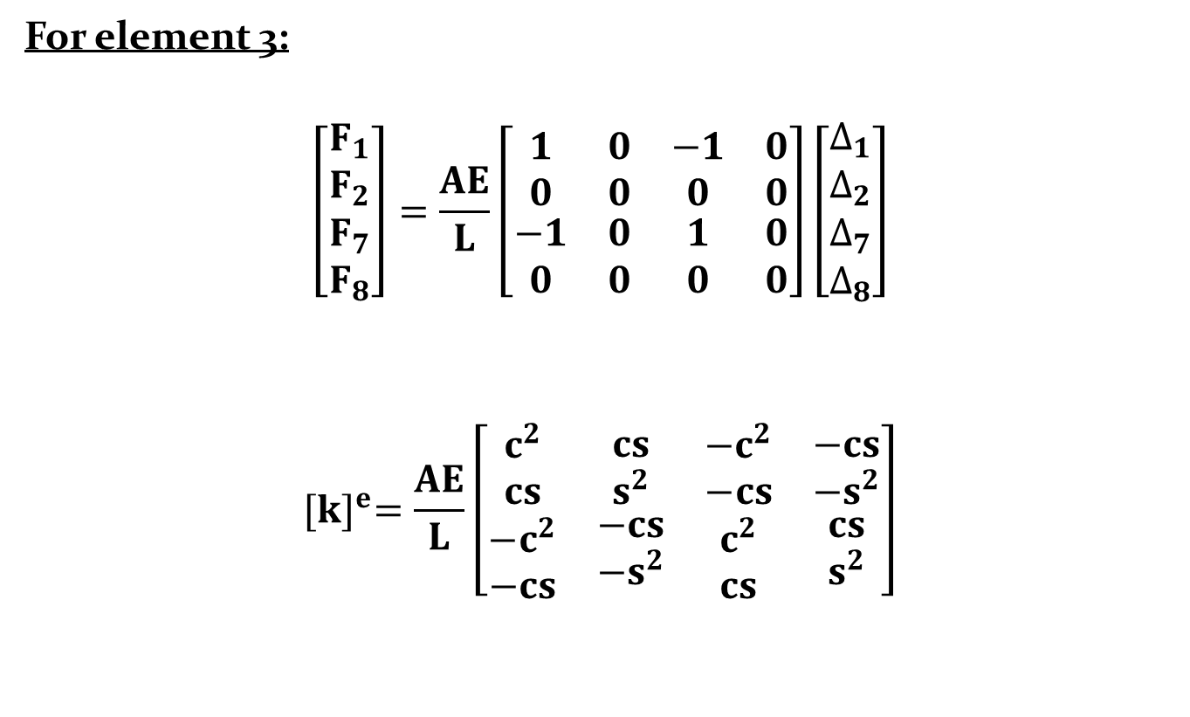
For element 3:
$$\left[\begin{matrix}\begin{matrix}F_{1} \\ F_{2}\end{matrix} \\ F_{7} \\ \begin{matrix}F_{8}\end{matrix}\end{matrix}\right]=\frac{AE}{L}\left[\begin{matrix}\begin{matrix}1 \\ 0 \\ \begin{matrix}−1 \\ 0\end{matrix}\end{matrix} & \begin{matrix}0 \\ 0 \\ \begin{matrix}0 \\ 0\end{matrix}\end{matrix} & \begin{matrix}\begin{matrix}−1 \\ 0 \\ \begin{matrix}1 \\ 0\end{matrix}\end{matrix} & \begin{matrix}\begin{matrix}0 \\ 0 \\ \begin{matrix}0 \\ 0\end{matrix}\end{matrix}\end{matrix}\end{matrix}\end{matrix}\right]\left[\begin{matrix}\begin{matrix}∆_{1} \\ ∆_{2}\end{matrix} \\ ∆_{7} \\ \begin{matrix}∆_{8}\end{matrix}\end{matrix}\right]$$
$${[k]}^{e}=\frac{AE}{L}\left[\begin{matrix}\begin{matrix}c^{2} \\ cs \\ \begin{matrix}−c^{2} \\ −cs\end{matrix}\end{matrix} & \begin{matrix}cs \\ s^{2} \\ \begin{matrix}−cs \\ −s^{2}\end{matrix}\end{matrix} & \begin{matrix}\begin{matrix}−c^{2} \\ −cs \\ \begin{matrix}c^{2} \\ cs\end{matrix}\end{matrix} & \begin{matrix}\begin{matrix}−cs \\ −s^{2} \\ \begin{matrix}cs \\ s^{2}\end{matrix}\end{matrix}\end{matrix}\end{matrix}\end{matrix}\right]$$

Slide 11
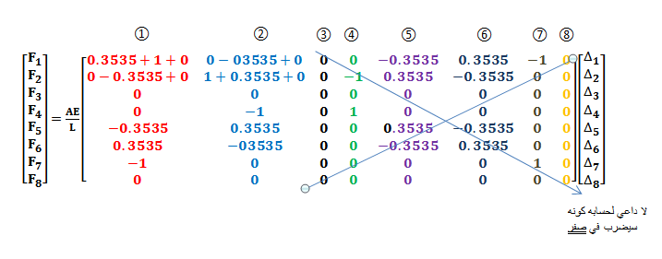
For overall structure:

Slide 12
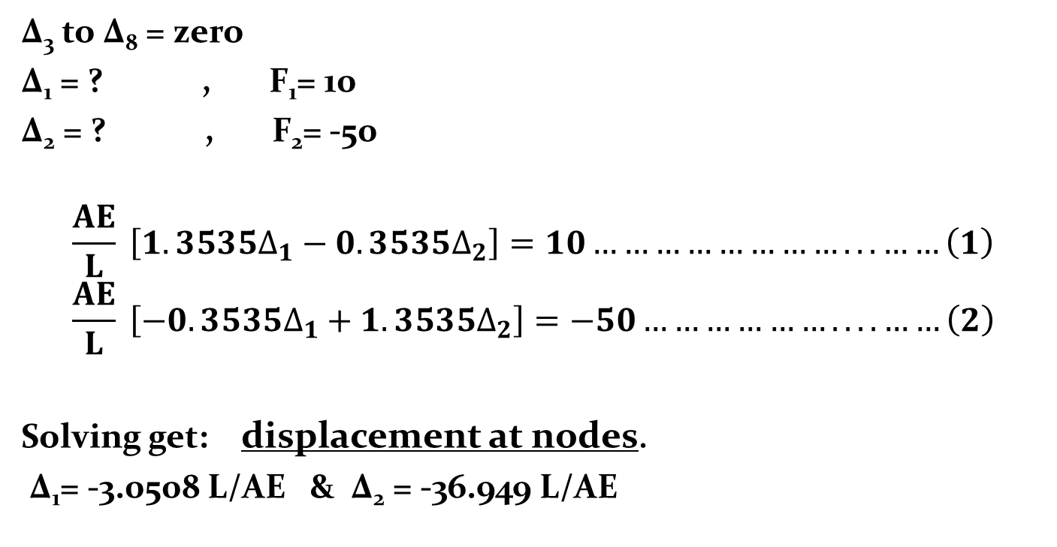
∆₃ to ∆₈ = zero
∆₁ = ? , F₁= 10
∆₂ = ? , F₂= -50
$$\frac{AE}{L} \left[1.3535∆_{1}−0.3535∆_{2}\right]=10……………………...……\left(1\right)$$
$$\frac{AE}{L} \left[−0.3535∆_{1}+1.3535∆_{2}\right]=−50………………....……\left(2\right)$$
Solving get: displacement at nodes.
∆₁= -3.0508 L/AE & ∆₂ = -36.949 L/AE

Slide 13
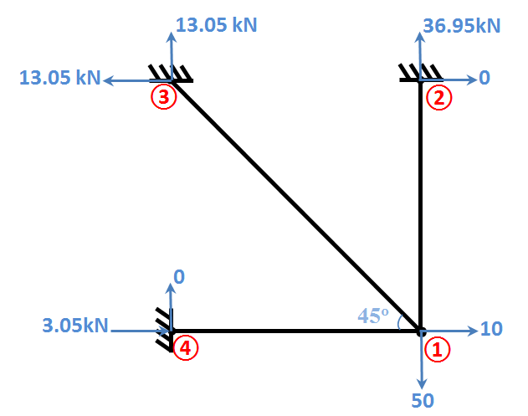
Support Reactions
F₃= 0
F₄= 36.95 kN ↑
F₅= -13.05 = +13.05 kN ←
F₆= 13.05 kN ↑
F₇= 3.05 kN →
F₈= 0
Answer

Slide 14
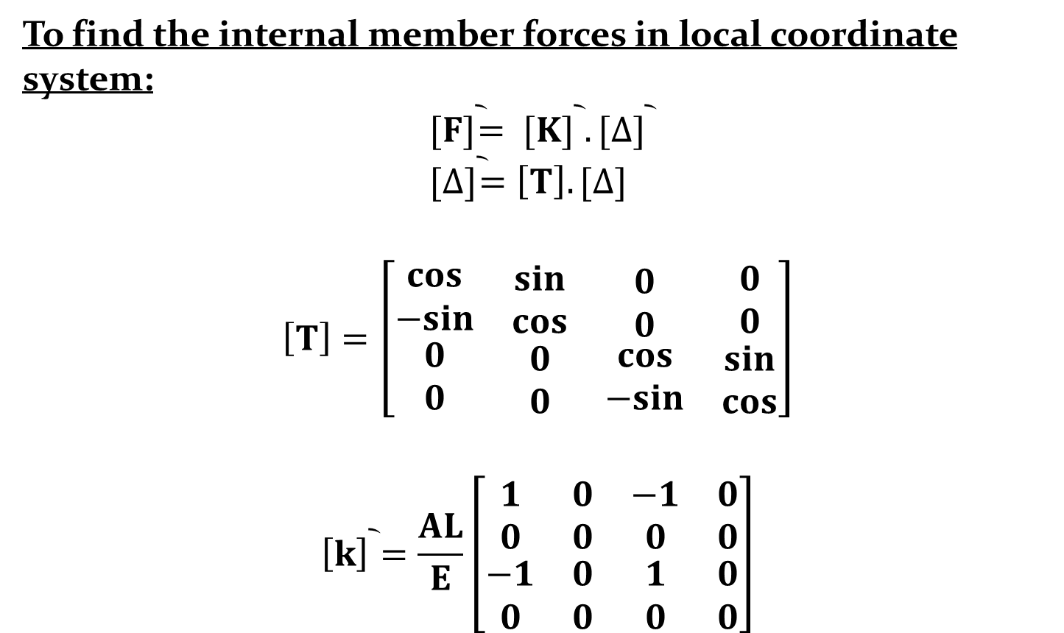
To find the internal member forces in local coordinate system:
$${[F]}^{︡}= {[K]}^{︡} . {[∆]}^{︡} \\ {[∆]}^{︡}=\left[T\right].[∆]$$
$$\left[T\right]=\left[\begin{matrix}\begin{matrix}cos \\ −sin \\ \begin{matrix}0 \\ 0\end{matrix}\end{matrix} & \begin{matrix}sin \\ cos \\ \begin{matrix}0 \\ 0\end{matrix}\end{matrix} & \begin{matrix}\begin{matrix}0 \\ 0 \\ \begin{matrix}cos \\ −sin\end{matrix}\end{matrix} & \begin{matrix}\begin{matrix}0 \\ 0 \\ \begin{matrix}sin \\ cos\end{matrix}\end{matrix}\end{matrix}\end{matrix}\end{matrix}\right]$$
$${\left[k\right]}^{︡}=\frac{AL}{E}\left[\begin{matrix}\begin{matrix}1 \\ 0 \\ \begin{matrix}−1 \\ 0\end{matrix}\end{matrix} & \begin{matrix}0 \\ 0 \\ \begin{matrix}0 \\ 0\end{matrix}\end{matrix} & \begin{matrix}\begin{matrix}−1 \\ 0 \\ \begin{matrix}1 \\ 0\end{matrix}\end{matrix} & \begin{matrix}\begin{matrix}0 \\ 0 \\ \begin{matrix}0 \\ 0\end{matrix}\end{matrix}\end{matrix}\end{matrix}\end{matrix}\right]$$

Slide 15
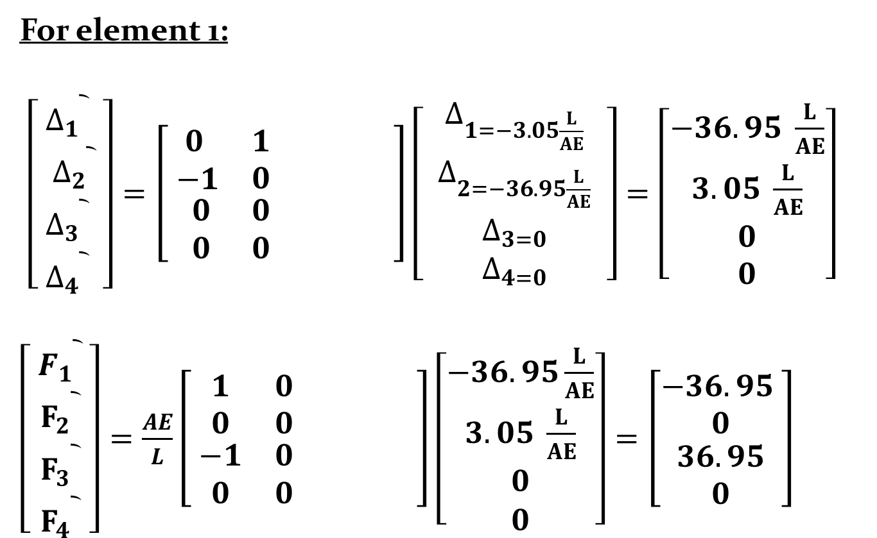
For element 1:
$\left[\begin{matrix}\begin{matrix}{∆_{1}}^{︡} \\ {{ ∆}_{2}}^{︡}\end{matrix} \\ {∆_{3}}^{︡} \\ \begin{matrix}{∆_{4}}^{︡}\end{matrix}\end{matrix} \right]=\left[\begin{matrix}\begin{matrix}0 \\ −1 \\ \begin{matrix}0 \\ 0\end{matrix}\end{matrix} & \begin{matrix}1 \\ 0 \\ \begin{matrix}0 \\ 0\end{matrix}\end{matrix} & \begin{matrix}\begin{matrix} \\ \\ \begin{matrix} \\ \end{matrix}\end{matrix} & \begin{matrix}\begin{matrix} \\ \\ \begin{matrix} \\ \end{matrix}\end{matrix}\end{matrix}\end{matrix}\end{matrix}\right]\left[ \begin{matrix}\begin{matrix}∆_{1=−3.05\frac{L}{AE}} \\ ∆_{2=−36.95\frac{L}{AE}}\end{matrix} \\ ∆_{3=0} \\ \begin{matrix}∆_{4=0}\end{matrix}\end{matrix} \right]=\left[\begin{matrix}−36.95 \frac{L}{AE} \\ 3.05 \frac{L}{AE} \\ \begin{matrix}0 \\ 0\end{matrix}\end{matrix}\right]$
$\left[ \begin{matrix}\begin{matrix}{F_{1}}^{︡} \\ {F_{2}}^{︡}\end{matrix} \\ {F_{3}}^{︡} \\ \begin{matrix}{F_{4}}^{︡}\end{matrix}\end{matrix} \right]=\frac{AE}{L}\left[ \begin{matrix}\begin{matrix}1 \\ 0 \\ \begin{matrix}−1 \\ 0\end{matrix}\end{matrix} & \begin{matrix}0 \\ 0 \\ \begin{matrix}0 \\ 0\end{matrix}\end{matrix} & \begin{matrix}\begin{matrix} \\ \\ \begin{matrix} \\ \end{matrix}\end{matrix} & \begin{matrix}\begin{matrix} \\ \\ \begin{matrix} \\ \end{matrix}\end{matrix}\end{matrix}\end{matrix}\end{matrix}\right]\left[\begin{matrix}\begin{matrix}−36.95\frac{L}{AE} \\ 3.05 \frac{L}{AE}\end{matrix} \\ 0 \\ \begin{matrix}0\end{matrix}\end{matrix}\right]=\left[\begin{matrix}−36.95 \\ 0 \\ \begin{matrix}36.95 \\ 0\end{matrix}\end{matrix}\right]$
لا داعي لحسابه
لا داعي لحسابه

Slide 16
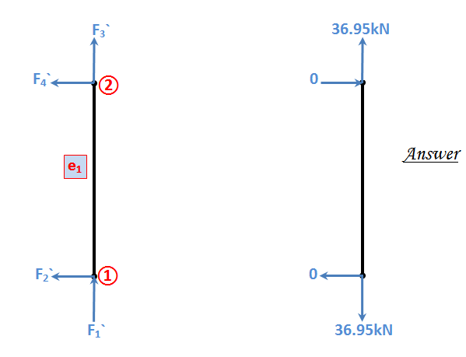

Slide 17
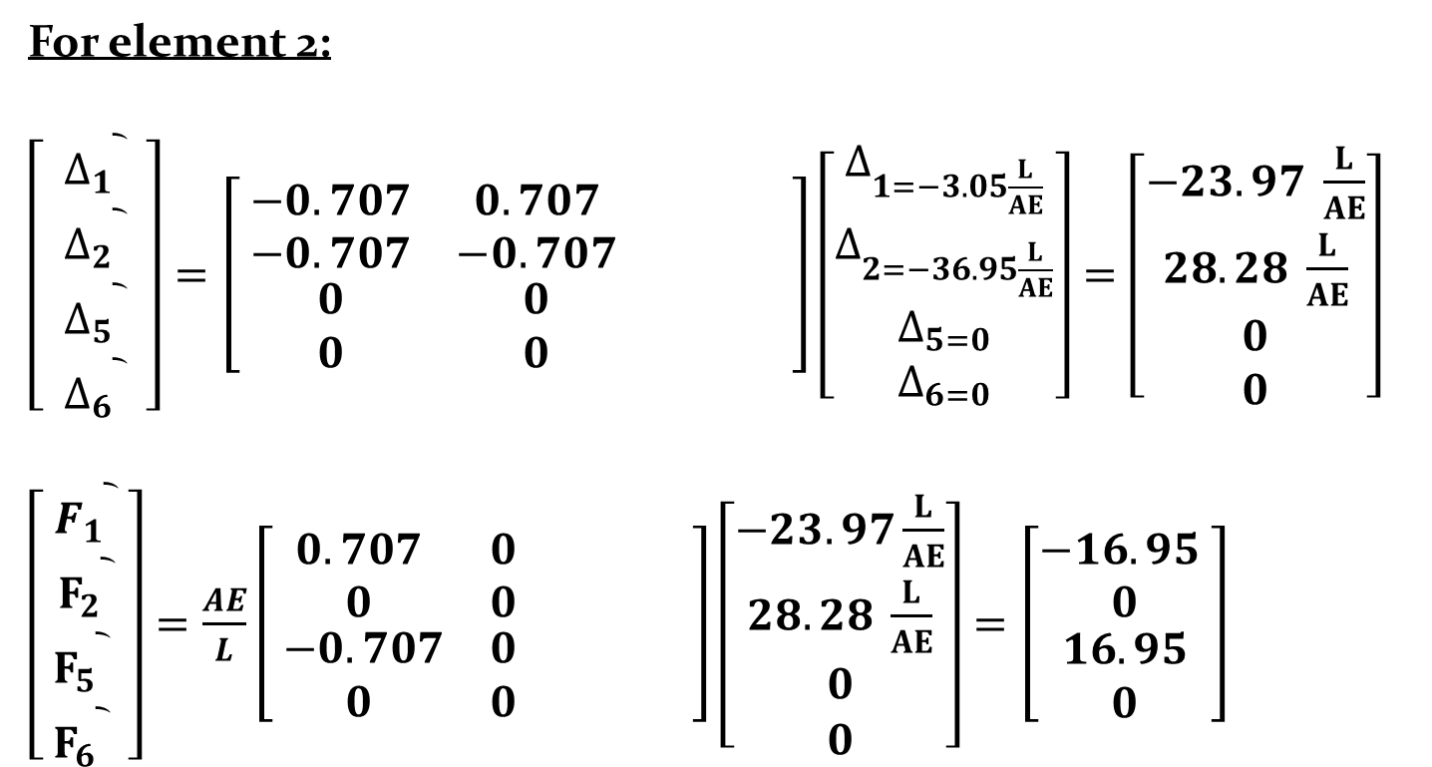
For element 2:
$\left[ \begin{matrix}\begin{matrix}{∆_{1}}^{︡} \\ {∆_{2}}^{︡}\end{matrix} \\ {∆_{5}}^{︡} \\ \begin{matrix}{∆_{6}}^{︡}\end{matrix}\end{matrix} \right]=\left[ \begin{matrix}\begin{matrix}−0.707 \\ −0.707 \\ \begin{matrix}0 \\ 0\end{matrix}\end{matrix} & \begin{matrix}0.707 \\ −0.707 \\ \begin{matrix}0 \\ 0\end{matrix}\end{matrix} & \begin{matrix}\begin{matrix} \\ \\ \begin{matrix} \\ \end{matrix}\end{matrix} & \begin{matrix}\begin{matrix} \\ \\ \begin{matrix} \\ \end{matrix}\end{matrix}\end{matrix}\end{matrix}\end{matrix}\right]\left[\begin{matrix}\begin{matrix}∆_{1=−3.05\frac{L}{AE}} \\ ∆_{2=−36.95\frac{L}{AE}}\end{matrix} \\ ∆_{5=0} \\ \begin{matrix}∆_{6=0}\end{matrix}\end{matrix}\right]=\left[\begin{matrix}−23.97 \frac{L}{AE} \\ 28.28 \frac{L}{AE} \\ \begin{matrix}0 \\ 0\end{matrix}\end{matrix}\right]$
$\left[\begin{matrix} \begin{matrix}{F_{1}}^{︡} \\ {F_{2}}^{︡}\end{matrix} \\ {F_{5}}^{︡} \\ \begin{matrix}{F_{6}}^{︡}\end{matrix}\end{matrix} \right]=\frac{AE}{L}\left[\begin{matrix}\begin{matrix}0.707 \\ 0 \\ \begin{matrix} −0.707 \\ 0\end{matrix}\end{matrix} & \begin{matrix}0 \\ 0 \\ \begin{matrix}0 \\ 0\end{matrix}\end{matrix} & \begin{matrix}\begin{matrix} \\ \\ \begin{matrix} \\ \end{matrix}\end{matrix} & \begin{matrix}\begin{matrix} \\ \\ \begin{matrix} \\ \end{matrix}\end{matrix}\end{matrix}\end{matrix}\end{matrix}\right]\left[\begin{matrix}\begin{matrix}−23.97\frac{L}{AE} \\ 28.28 \frac{L}{AE}\end{matrix} \\ 0 \\ \begin{matrix}0\end{matrix}\end{matrix}\right]=\left[\begin{matrix}−16.95 \\ 0 \\ \begin{matrix}16.95 \\ 0\end{matrix}\end{matrix}\right]$
لا داعي لحسابه
لا داعي لحسابه

Slide 18
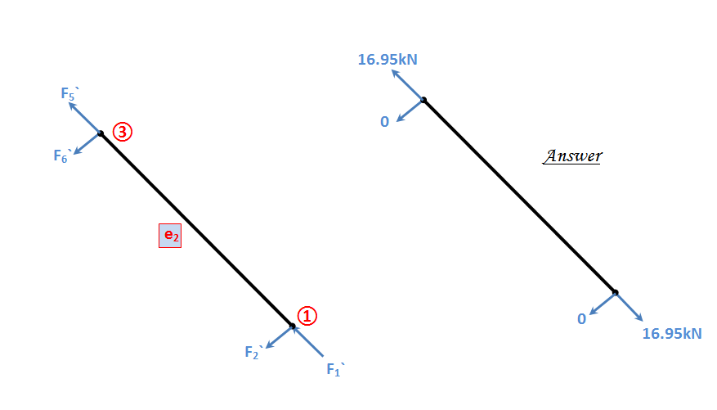

Slide 19
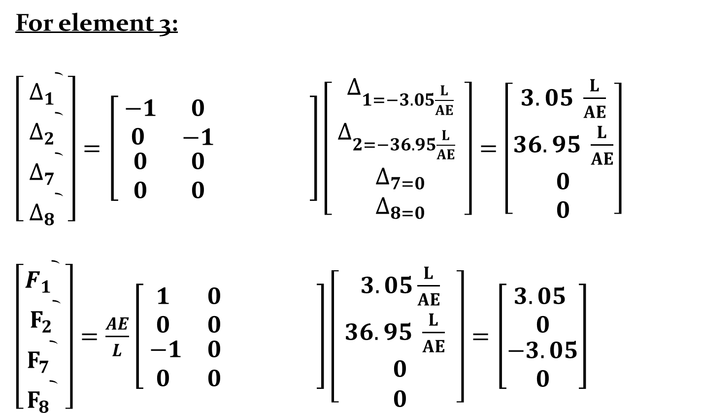
For element 3:
$\left[ \begin{matrix}\begin{matrix}{∆_{1}}^{︡} \\ {∆_{2}}^{︡}\end{matrix} \\ {∆_{7}}^{︡} \\ \begin{matrix}{∆_{8}}^{︡}\end{matrix}\end{matrix} \right]=\left[\begin{matrix}\begin{matrix} −1 \\ 0 \\ \begin{matrix}0 \\ 0\end{matrix}\end{matrix} & \begin{matrix}0 \\ −1 \\ \begin{matrix}0 \\ 0\end{matrix}\end{matrix} & \begin{matrix}\begin{matrix} \\ \\ \begin{matrix} \\ \end{matrix}\end{matrix} & \begin{matrix}\begin{matrix} \\ \\ \begin{matrix} \\ \end{matrix}\end{matrix}\end{matrix}\end{matrix}\end{matrix}\right]\left[ \begin{matrix}\begin{matrix}∆_{1=−3.05\frac{L}{AE}} \\ ∆_{2=−36.95\frac{L}{AE} }\end{matrix} \\ ∆_{7=0} \\ \begin{matrix}∆_{8=0}\end{matrix}\end{matrix}\right]=\left[\begin{matrix}3.05 \frac{L}{AE} \\ 36.95 \frac{L}{AE} \\ \begin{matrix}0 \\ 0\end{matrix}\end{matrix}\right]$
$\left[\begin{matrix}\begin{matrix}{F_{1}}^{︡} \\ {F_{2}}^{︡}\end{matrix} \\ {F_{7}}^{︡} \\ \begin{matrix}{F_{8}}^{︡}\end{matrix}\end{matrix} \right]=\frac{AE}{L}\left[\begin{matrix}\begin{matrix}1 \\ 0 \\ \begin{matrix} −1 \\ 0\end{matrix}\end{matrix} & \begin{matrix}0 \\ 0 \\ \begin{matrix}0 \\ 0\end{matrix}\end{matrix} & \begin{matrix}\begin{matrix} \\ \\ \begin{matrix} \\ \end{matrix}\end{matrix} & \begin{matrix}\begin{matrix} \\ \\ \begin{matrix} \\ \end{matrix}\end{matrix}\end{matrix}\end{matrix}\end{matrix}\right]\left[ \begin{matrix}\begin{matrix}3.05\frac{L}{AE} \\ 36.95 \frac{L}{AE} \end{matrix} \\ 0 \\ \begin{matrix}0\end{matrix}\end{matrix}\right]=\left[\begin{matrix}3.05 \\ 0 \\ \begin{matrix}−3.05 \\ 0\end{matrix}\end{matrix}\right]$
لا داعي لحسابه
لا داعي لحسابه

Slide 20
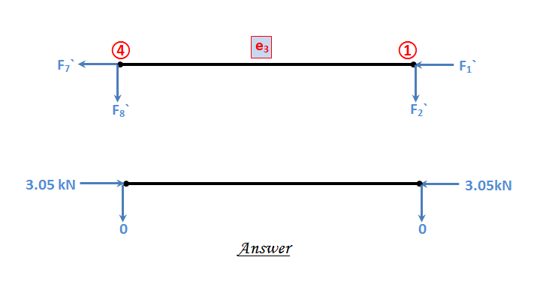

Slide 21
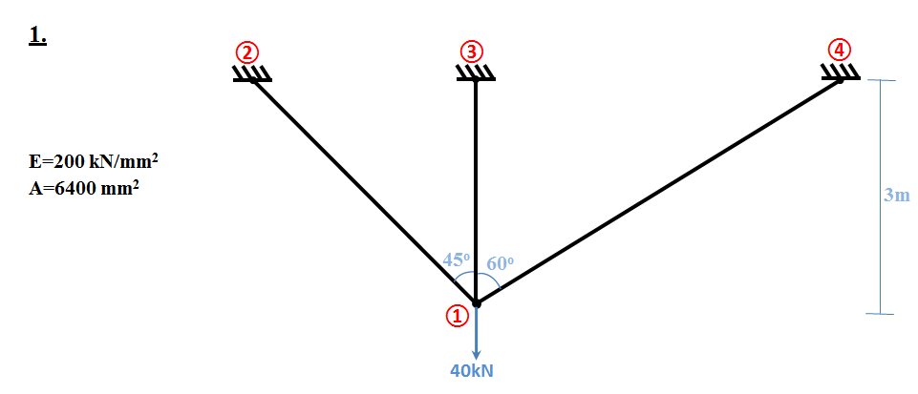
H.W: Use stiffness matrix method to find:
The displacements at nodes.
The supports reactions.
The internal members forces.

Slide 22
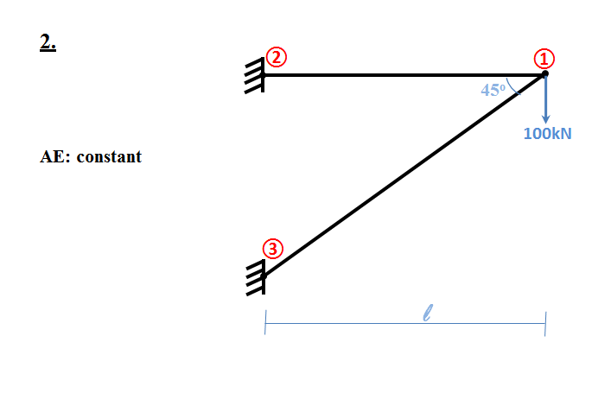

Slide 23
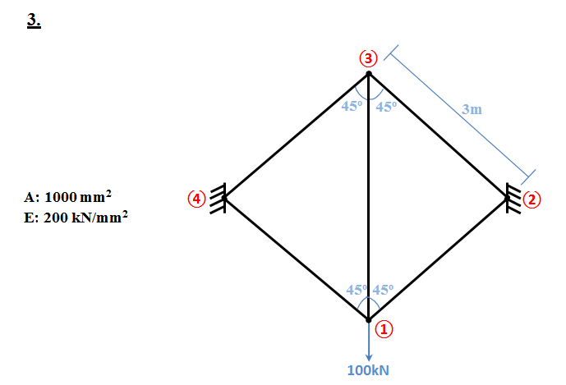

Slide 24
